Slide 1




E-commerce
AMAZON CLONE

Slide 2


EXTRA ENDPOINTS
A Showcase of 5 Custom Endpoints Implemented to Enhance User Experience and System Efficiency.

Slide 3


REWARD POINTS
Display Reward Points
Description: Displays how many reward points a user has accumulated.
HTTP Method: GET
Endpoint: /getRewardPoints/{userId}
logic : Checks if the user exists.
Returns the total reward points for the user.
Returns an error if the user is not found

Slide 4
REWARD POINTS
Use Reward Points
Description: Allows users to redeem their reward points for balance.
HTTP Method: PUT
Endpoint: /useRewardPoints/{userId}/{pointsToUse}
Logic:Validates if the user exists and has enough points.
Deducts the redeemed points and adds equivalent value to the user's balance.
Returns success or an error if user/points are invalid.

Slide 5


WISHLIST
○Adds a product to a user's wishlist.
○Displays all products in a user's wishlist.

Slide 6

ADD TO WISHLIST /DISPLAY WISHLIST
Description: Adds a product to a user's wishlist
HTTP Method: PUT
Endpoint: /addToWishlist/{userId}/{productId}
logic: Validates if the user and product exist.
Adds the product to the wishlist.
Returns a success message or an error if user/product is not found.
Description: Displays all products in a user's wishlist.
HTTP Method: GET
Endpoint: /displayWishList/{userId}
Logic: Fetches the wishlist for a specific user using their userId.
Returns the list of products or a 404 error if the user is not found.

Slide 7

RETURN PRODUCT
Description: Allows a user to return a purchased product.
HTTP Method: PUT
Endpoint: /return/{userId}/{productId}
Logic : Verifies if the user and product exist.
Updates the product stock and refunds the user.
Returns a success message or an error if user/product is not found.

Slide 8
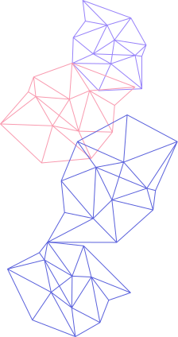



COMPARE PRODUCTS
Description: Compares the specifications of multiple products.
HTTP Method: Get
Endpoint: /compareProducts
Logic : Accepts a list of product IDs from the user.
Fetches the details of the specified products.
Validates if all products exist.
Returns a comparison of the fetched products, or an error if any product is not found.

Slide 9
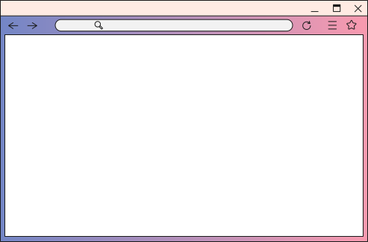

LOW STOCK PRODUCTS
Description: Displays products with low stock for a specific merchant
HTTP Method: GET
Endpoint: /lowStock/{merchantId}
Logic : Retrieves products for the specified merchant with stock below a defined threshold (e.g., <= 3).
Returns the list of low-stock products or an empty list if none are found.

Slide 10
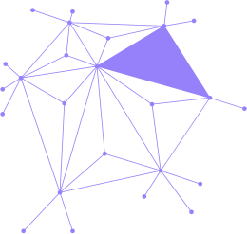
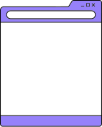
Endpoints Overview:
1. Display Reward Points/Use Reward Points
2. Display Wishlist/Add to Wishlist
3. Return Product
4. Compare Products
5. Low Stock Products
Each endpoint is designed to enhance user experience and streamline workflows.
SUMMARY

Slide 11
THANK
Bayan Basrana
Capstone 1
YOU!
Amazon clone

